Slide 1
Topic: Sector Area Formula
What is coming up?
First investigation coming up in Week 3!
EQ: How to find the area of only part of a circle?
Ms. Latham

Slide 2
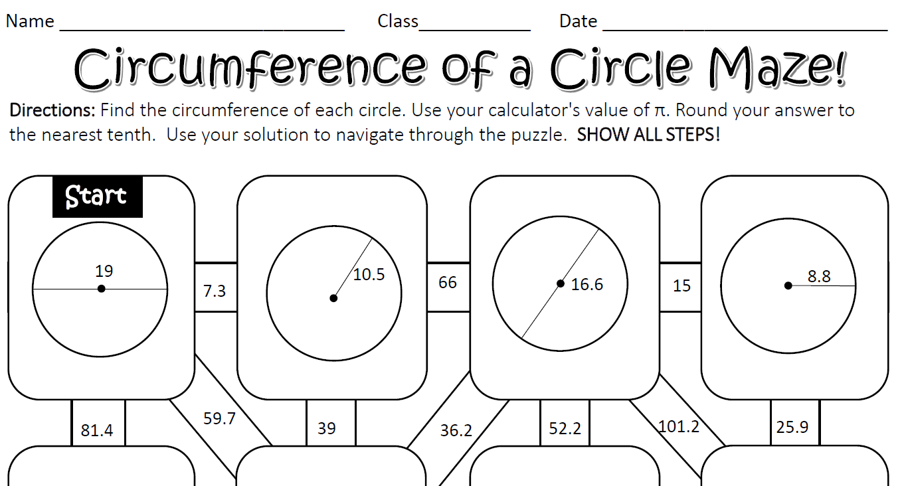
Warm – Up

Slide 3
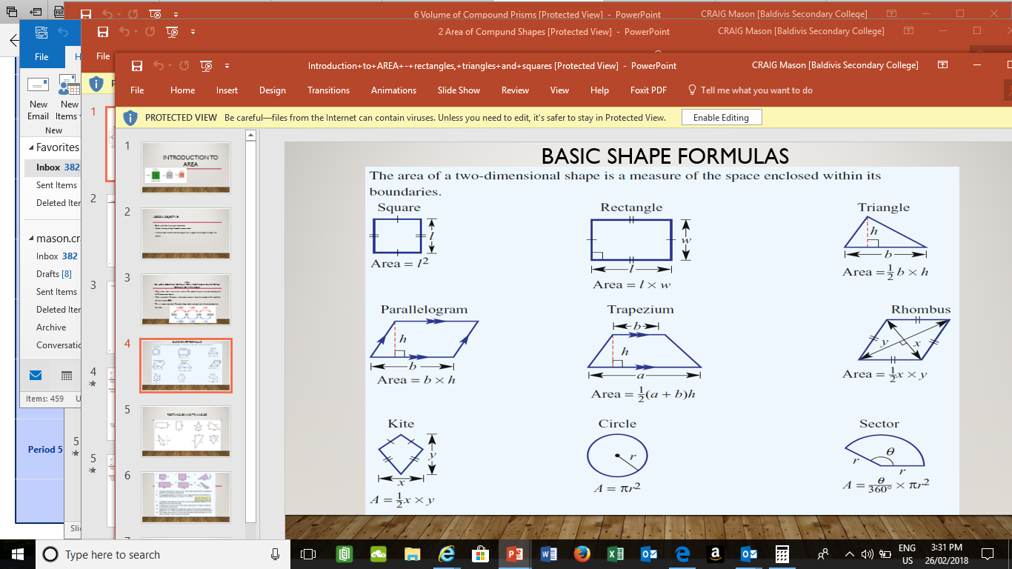
Topic: Sector Area Formula
How to find the area of only part of a circle?
EQ:
What is a sector?
Formula
A ‘pie-slice’ part of a circle
ϴ : Greek letter ‘Theta’ represents an angle

Slide 4
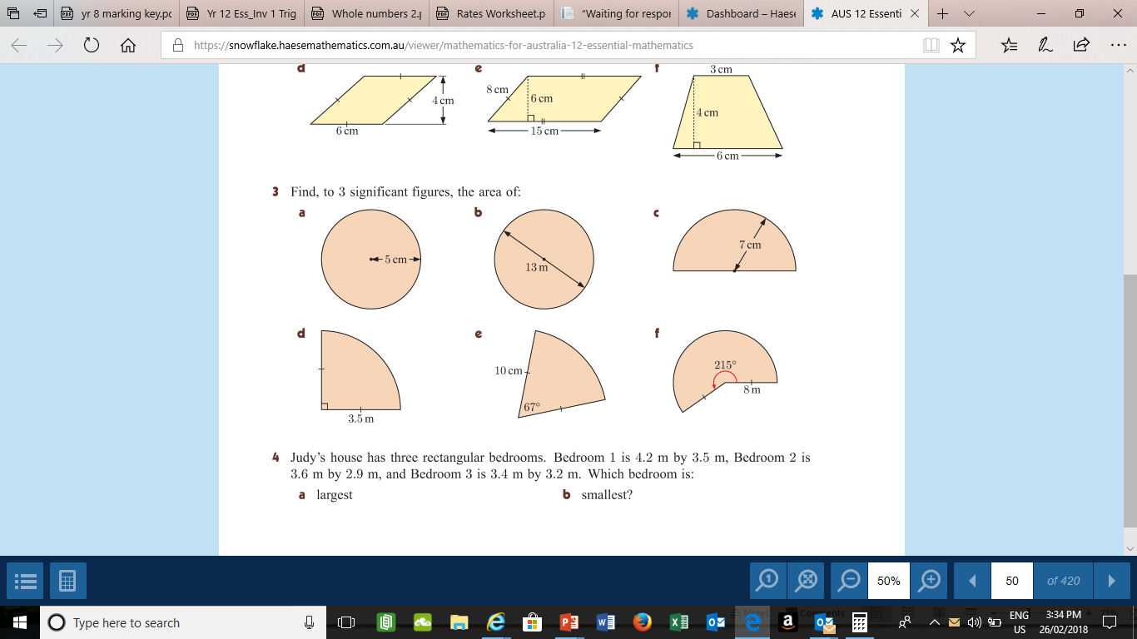
We Do

Slide 5
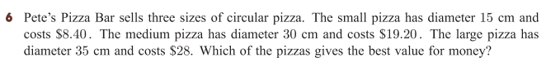
You Do
Area of Sectors Work Sheet

